Slide 1
Assignment #1 Data Processing and Visualization
Qianyu Ouyang
oyqy19@mails.tsinghua.edu.cn
Notes:
Hello, everyone, I will introduce the details about the assignment one: Data processing and visualization

Slide 2

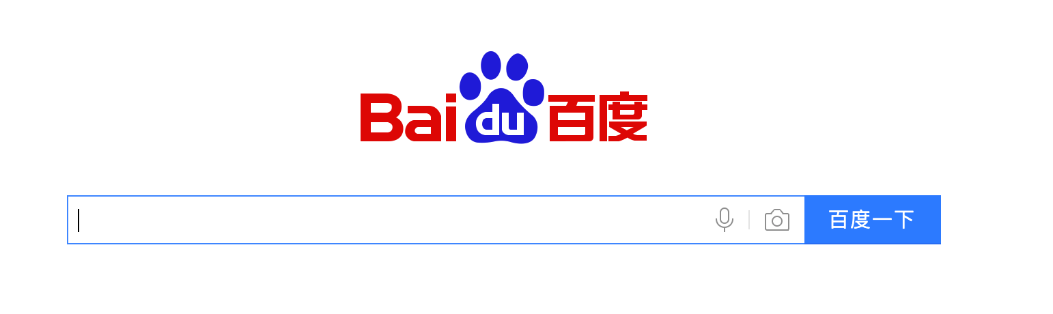

Background
Search engines
Notes:
First, the background about this assignment is search engine. As we all know, Web search engines are one of the most popular Internet applications and have become an indispensable part in our daily life. Like baidu and google. In this assignment, we will access the real data from a top search engine

Slide 3
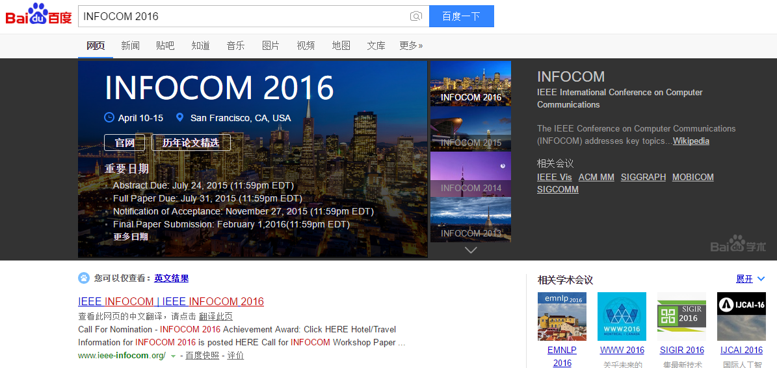
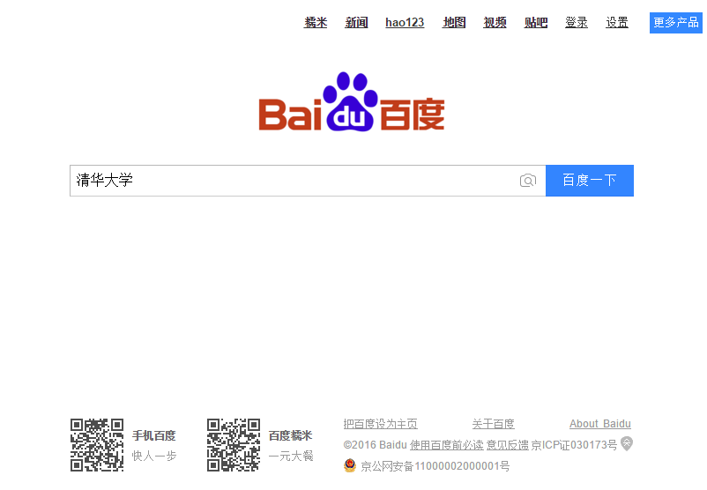


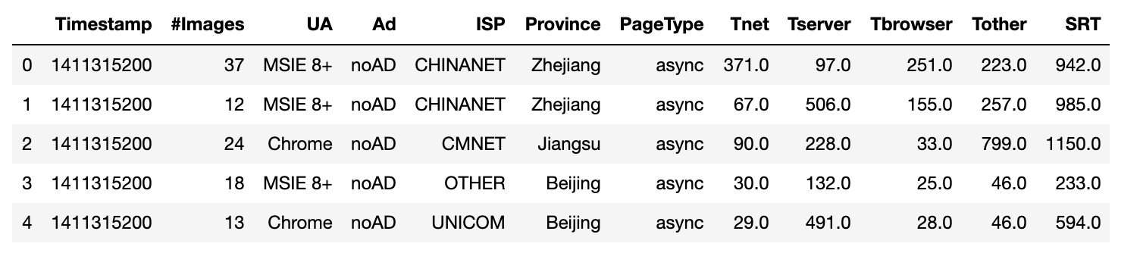
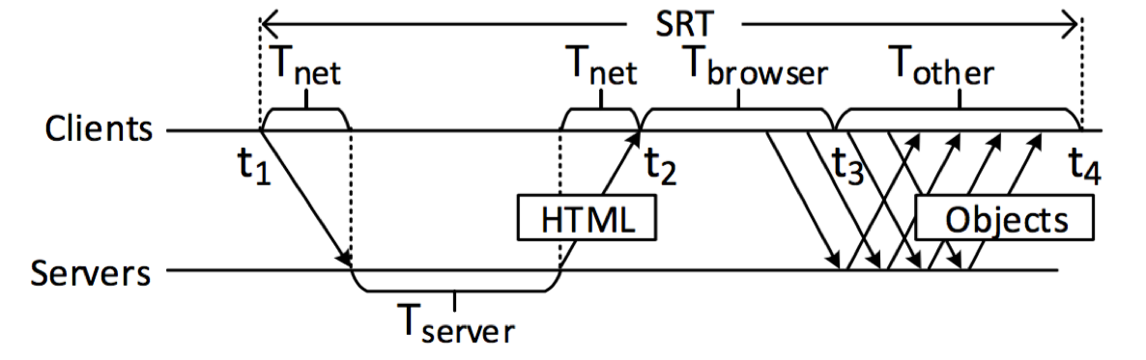
Data description
Search logs
Illustrating of SRT.
Notes:
In general, once you submit a query to a search engine, the search engine will log some related attributes regarding this query, such as a row in this table
Here we present the first five lines of data in our assignment.
Timestamp records the time when the query is submitted.
Images is the number of images embedded in the result page.
UA is the type of browser from which the query is submitted.
Ad records whether the result page contains ads or not, The last column SRT is the time between you submit your search query and the result page is rendered，which is the sum of the above four SRT components.

Slide 4
Jobs
2 weeks of search logs from a global top search engine
Basic statistics: coding to count the data in different ways, e.g., how many queries are served per minute.
Visualization: plot various figures to show the data intuitively (e.g., line chart, histogram)
Notes:
In this assignment, you will use the two weeks of search logs for basic statistics, such as counting data in different ways, data visualization, for example, plot line chart, cdf chart.

Slide 5
Jobs
Calculate the average SRT of every 10 minutes, and plot the SRT with a line chart (x axis for date time and y axis for the average SRT).
Calculate the average of each SRT component of every 10 minute, and plot the four SRT components together with a stacked area chart (x axis for date time and y axis for time) and also a 100% stacked area chart (y axis for the percentage).
Plot the CDF (Cumulative distribution function) chart of SRT.
Plot the CDF chart of #Images.
Count the number of queries (also called page views or PVs) of each minute, and plot the minute-level PVs with a line chart (x axis for date time and y axis for the PVs).
Count the PVs of each province, and plot it with a histogram chart (x axis for province and y axis for PVs).
Count the PVs of each UA, and plot it with a pie chart (show the percentages in the chart).
What are the differences among those charts (How to decide which one to use)
Describe your experience or findings in doing those jobs. For example, experience of processing the data, observations from the charts, characteristics of the data, potential explanations, and any interesting things you would like to mention.
Notes:
In detail,, you need to do these jobs in this assignment
for example, in job 1, you need to use the timestamp column and SRT column to get the average SRT of every 10 minutes。
And then, you need to plot line chart, stacked area chart and cdf chart to describe the SRT information.
In The last two jobs, you need to answer your interesting insights about the data when you finish the assignment 1

Slide 6
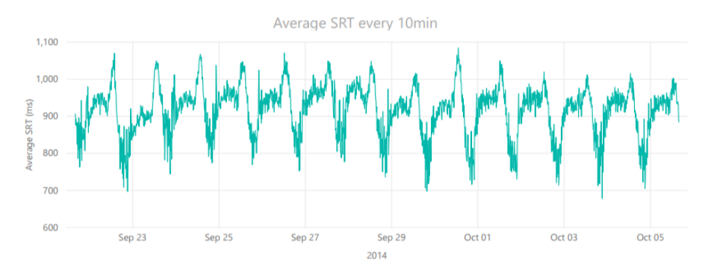
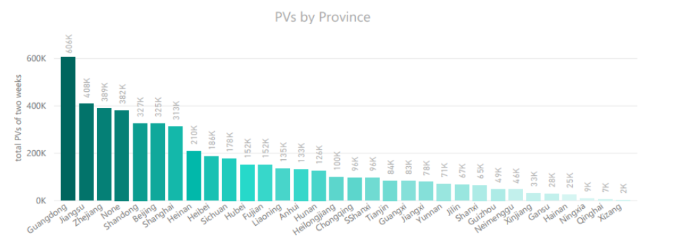
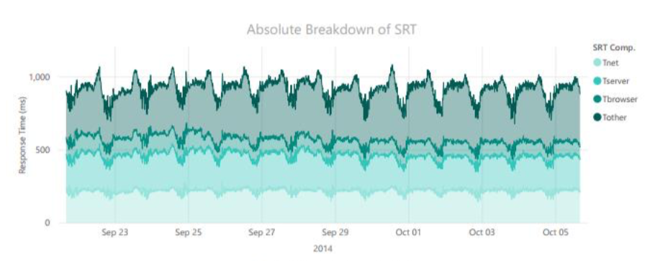
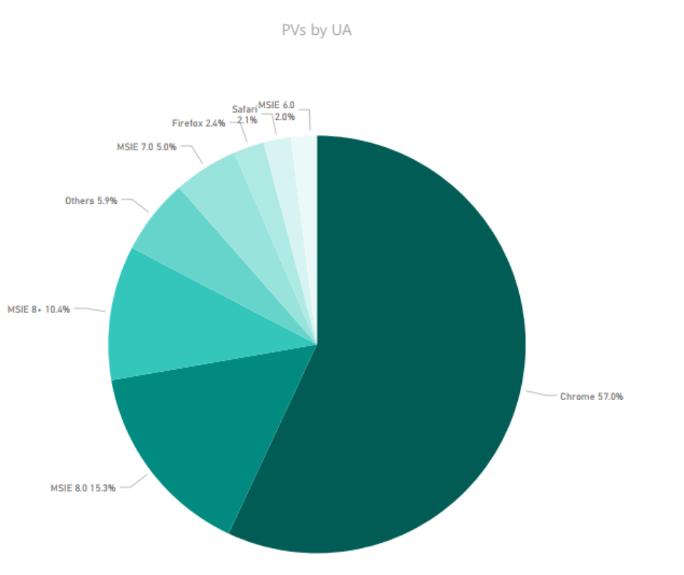
Jobs
Notes:
These are some examples of figures you need to plot. which are plotted by power BI

Slide 7

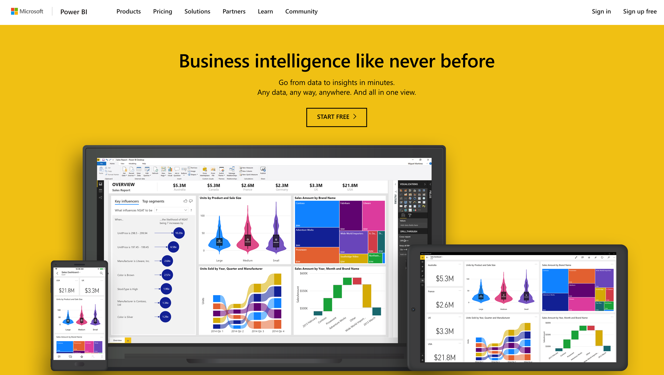

Tools
…
Coding
Matplotlib
Matlab
Data analysis
tools
…
Power BI
Tableau
Notes:
If you are good at coding, you can use python with matplotlib, matlab.
You can also try some intelligent data analysis tools, like power BI, tableau

Slide 8
Requirements
Submit an assignment report, in which you describe the results of all the jobs in detail. For example, some jobs require you to plot a figure, then you have to put the figure into the report; some give you questions, then answer them.
We will give you the grade of the assignment based on the report only.
Deadline: Oct.6, 23:59
Notes:
about the requirements: An assignment report is required for submission, in which you describe the result of all the jobs in detail. For example, some jobs require you to plot a figure, then you have to put the figure into the report; some give you questions, then answer them.

Slide 9
Thank you!
Assignment data:
https://www.dropbox.com/s/akef557hnla0h9v/ANM-data.zip?dl=0
Notes:
If you have any questions, or if you have technical difficulties about the assignment, please feel free to have discussion in wechat group.
And you can download the assignment data from dropbox, That’s all, Thank you!

